Slide 1



IPL Score Predictor
Student Name
Company
Guide
Pooja Patel
Pavitrasoft
Jitendra Raulji

Slide 2
01 / Overview
Introduction
Cricket: A Global Phenomenon
Project Purpose
Cricket stands as one of the most popular sports worldwide, captivating billions of fans across continents. The Indian Premier League (IPL) has revolutionized the sport, combining world-class talent with cutting-edge technology.
This project develops a sophisticated machine learning system that predicts the final IPL score based on current match conditions, providing real-time insights for strategic decision-making.
Data Science in Sports
Predicting match scores using data science helps teams, analysts, and fans make informed decisions . Machine learning algorithms analyze historical patterns to forecast outcomes with remarkable accuracy.
Real-time
Analysis
ML
Powered
User
Friendly
High
Accuracy

Slide 3
02 / Challenge
Problem Statement
The Challenge
Objective
During a live IPL match, predicting the final score is extremely difficult due to numerous dynamic variables including pitch conditions, player form, weather, and match pressure.
Build a Machine Learning model that predicts IPL final score using comprehensive match parameters and historical data patterns.
Unpredictable Variables
Dynamic Conditions
Traditional Limitations
Stakeholder Needs
Human estimation lacks precision
Fans, analysts, and teams all require accurate predictions to enhance viewing experience, develop strategies, and make data-driven decisions during matches.
Limited data consideration
Subjective bias in predictions
No real-time adaptation
Fans
Analysts
Teams

Slide 4
03 / Goals
Project Objectives
01
Analyze IPL
Match Data
02
Clean &
Preprocess Data
03
Feature
Engineering
Comprehensive analysis of historical IPL match data to identify patterns, trends, and key performance indicators that influence match outcomes.
Implement robust data cleaning and preprocessing techniques to handle missing values, remove inconsistencies, and prepare data for model training.
Create meaningful features from raw data including team statistics, venue performance, current match status, and recent performance metrics.
04
Train ML
Model
05
Create Web
Interface
06
Real-time
Prediction
Develop and train machine learning models using algorithms like Random Forest and Linear Regression to predict final scores accurately.
Build an intuitive web application using Flask/Streamlit that allows users to input match parameters and receive instant predictions.
Provide real-time score predictions based on current match conditions, enabling users to make informed decisions during live matches.

Slide 5
04 / Tech Stack
Technologies Used
Programming Language
Libraries
Python
Pandas
NumPy
Data Analysis
Numerical Computing
Primary development language for ML and data processing
Scikit-learn
Matplotlib
ML Algorithms
Visualization
Development Tools
Seaborn
Statistical Visualization
Jupyter
VS Code
Notebook
Editor
Web Interface
Streamlit
HTML/CSS

Slide 6
05 / Data
Dataset Description
Dataset Overview
Key Dataset Features
Batting Team
Bowling Team
Comprehensive IPL historical match dataset spanning multiple seasons, containing detailed match statistics and ball-by-ball data for training the prediction model.
Team currently batting with historical performance metrics
Opposition team with bowling statistics and strategies
900+
15+
City / Venue
Runs Scored
Matches
Seasons
Match location affecting pitch conditions and performance
Current total runs scored by the batting team
Overs Bowled
Wickets Fallen
Data Quality
Number of overs completed in the innings
Number of wickets lost affecting team strength
Completeness
98%
Runs in Last 5 Overs
Accuracy
High
Recent scoring momentum indicating current form and run rate
Consistency
Verified

Slide 7
06 / Preprocessing
Data Cleaning
Removed Unnecessary Columns
Formatted Overs Data
Eliminated irrelevant features like player names, umpire details, and match IDs that don't contribute to score prediction.
Standardized overs format converting balls to decimal representation for consistent numerical processing.
Handled Missing Values
Removed Inconsistent Records
Applied appropriate imputation techniques for missing data points using statistical methods and domain knowledge.
Eliminated matches with incomplete data, abandoned games, and records with logical inconsistencies.
Filtered Valid IPL Teams
Tools Used
Retained only current and historically significant IPL teams, removing defunct or non-IPL team entries.
Pandas
Python

Slide 8
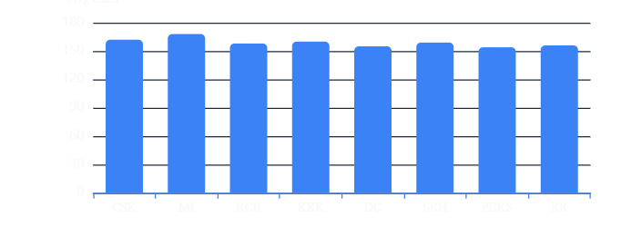
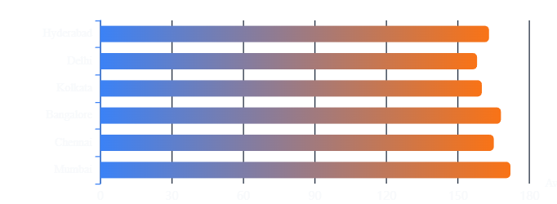
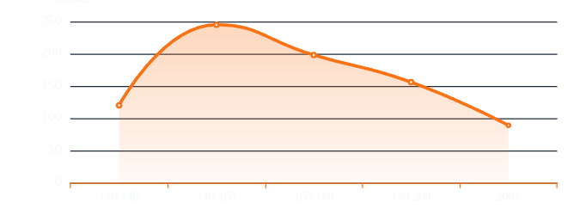
07 / Analysis
Data Exploration
Team Performance Comparison
Performance by City
Runs Distribution
Average Runs per Match
165
158
1st Innings
2nd Innings
Based on IPL historical data analysis (2008-2025)

Slide 9
08 / Features
Feature Engineering
Batting Team
Bowling Team
City
Current Score
Team's historical performance, batting strength, and current form significantly impact scoring potential.
Opposition's bowling attack quality and historical economy rates affect scoring difficulty.
Venue characteristics including pitch behavior, ground dimensions, and weather conditions.
Runs already scored provides baseline for projecting final total based on remaining resources.
High Impact
High Impact
Medium Impact
Critical
Overs Bowled
Wickets Fallen
Runs in Last 5 Overs
Progress of innings determines remaining balls and required run rate for projection.
Number of wickets lost affects batting team strength and remaining firepower.
Recent scoring momentum is a strong indicator of current batting form and team confidence. This feature captures the run rate trend and helps predict acceleration or deceleration in scoring.
Critical
High Impact
Highest Predictive Value

Slide 10
09 / ML Approach
Machine Learning Model
Supervised Learning
Algorithms Evaluated
The model is trained on historical IPL data with known outcomes, learning patterns between input features and final scores.
Linear Regression
82%
Baseline Algorithm
Accuracy
Simple yet effective for establishing baseline predictions. Assumes linear relationship between features and target score.
Training Data
Target Labels
XGBoost
90%
Selected Model
Accuracy
Training Process
XGBoost is an advanced ensemble machine learning algorithm that combines multiple decision trees to improve prediction accuracy..
1
Data split into training (80%) and testing (20%) sets
2
Features fed into model with target final scores
Decision Tree
85%
3
Model learns patterns and relationships
Alternative
Accuracy
Performance evaluated on test data
Tree-based model making decisions based on feature splits. Easy to interpret but prone to overfitting.
4

Slide 11
10 / Training
Model Training Process
01
Split Dataset
Dataset divided into training (80%) and testing (20%) sets using stratified sampling to maintain data distribution.
Evaluation Metrics
RMSE
12.4
02
Train Model
Root Mean Square Error measures prediction deviation
XGBoost trained on selected features with hyperparameter tuning for optimal performance.
MAE
4.5
Mean Absolute Error shows average prediction error
03
Evaluate Performance
Model evaluated using multiple metrics including RMSE, MAE, and R² score to assess prediction accuracy.
R² Score
0.91
Coefficient of determination indicates model fit quality
04
Optimize Accuracy
Iterative optimization using cross-validation, feature selection, and hyperparameter refinement.
Key Achievements
91% Accuracy
Fast Predictions
Low Variance
Cross-Validated

Slide 12
11 / Application
Web Application Interface
User Inputs
More Inputs
Batting Team
Wickets Fallen
Select from dropdown menu
Enter wickets lost
Bowling Team
Runs in Last 5 Overs
Select opposition team
Enter recent runs scored
City
Choose match venue
Output
Current Score
Enter runs scored
Overs Bowled
Predicted Final Score
Enter completed overs
Model outputs estimated final IPL score based on input parameters

Slide 13
12 / Demo
Project Demo Screenshot
Interface Overview
The web interface features a clean, intuitive design with cricket stadium background, team selection dropdowns, input fields for match parameters, and a prominent predict button.
How It Works
1
User enters match details in input fields
2
Clicks "Predict Score" button
3
ML model processes inputs instantly
4
Predicted final score displayed
Tip: Enter accurate current match data for best prediction results.

Slide 14
13 / Obstacles
Challenges Faced
Data Preprocessing Complexity
Model Accuracy Improvement
Raw IPL data contained inconsistencies, missing values, and multiple formats requiring extensive cleaning.
Initial model accuracy was moderate, requiring optimization to achieve reliable predictions.
Solution: Implemented systematic data validation and preprocessing pipeline using Pandas
Solution: Feature engineering, hyperparameter tuning, and cross-validation
Handling Categorical Variables
UI Integration with ML Model
Team names, cities, and venues are categorical requiring encoding for ML algorithms.
Connecting the frontend interface with backend ML model required seamless API integration.
Solution: Applied One-Hot Encoding and Label Encoding techniques
Solution: Used Flask framework with RESTful API endpoints
Success Rate
All challenges successfully resolved with effective solutions

Slide 15

14 / Summary
Conclusion
Project Achievements
Successfully built an IPL Score Prediction System using Machine Learning
Used comprehensive cricket dataset with advanced preprocessing techniques
Built interactive web interface for real-time user predictions
Model estimates final scores using live match parameters with 91% accuracy
Future Improvements
Accuracy
Live API
Dashboard
Improve prediction accuracy using advanced ensemble methods
Add live match API integration for real-time data fetching
Create an interactive dashboard to visualize IPL match insights and predictions

